Slide 1
Mastering Data Visualization: Methods and Procedures
Dr Nay Win Aung
Deputy Director
Department of Medical Services

Slide 2
Introduction
- Brief overview: "Data visualization is the graphical representation of data to discover insights, patterns, and trends."
- Purpose: "Enhancing decision-making, communication, and understanding complex datasets."

Slide 3
Why Data Visualization?
- Benefits:
- Improved decision-making.
- Enhanced communication.
- Identifying patterns and trends efficiently.

Slide 4
Types of Data Visualizations
- Bar charts: Displaying categorical data.
- Line graphs: Illustrating trends over time.
- Pie charts: Showing parts of a whole.
- Scatter plots: Representing relationships between two variables.

Slide 5
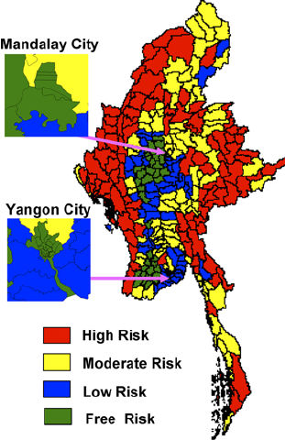
Heatmaps
- Explanation: Visualizing data intensity using colors.
- Use cases: Identifying hotspots in data, such as website user activity.

Slide 6
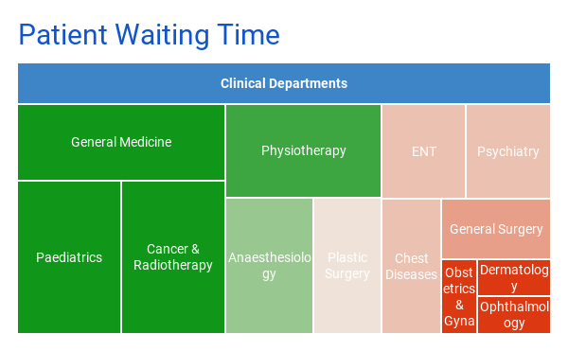
Treemaps
- Definition: Hierarchical visualization of data.
- Application: Displaying nested data structures or organizational hierarchies.

Slide 7
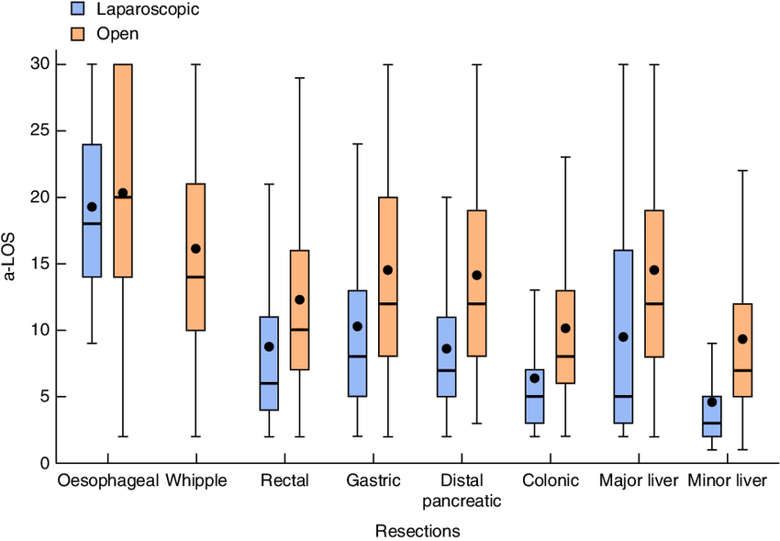
Box Plots
- Introduction: Visualizing the distribution of data.
- Interpretation: Understanding quartiles, outliers, and central tendencies.

Slide 8
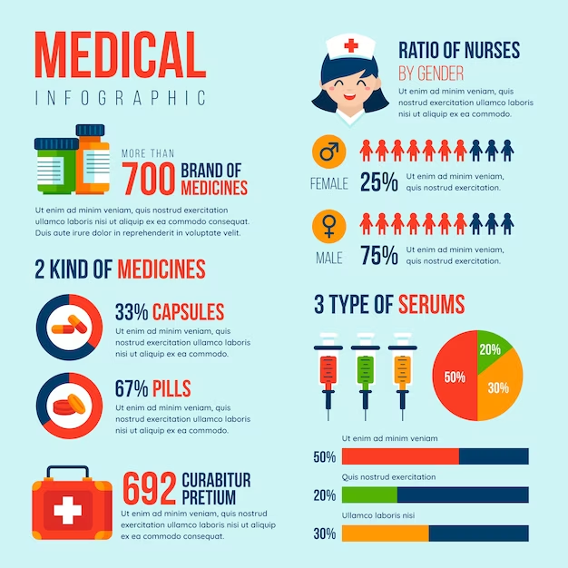
Infographics
- Overview: Integrating data into visually appealing graphics.
- Tips: Emphasize simplicity, relevance, and hierarchy in infographic design.

Slide 9
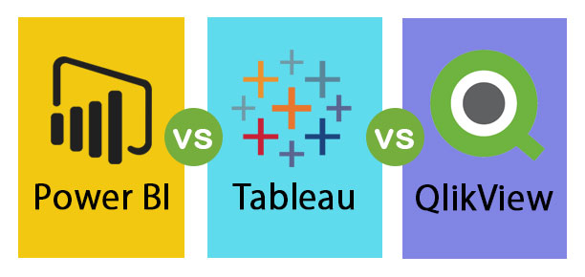
Data Visualization Tools
- Introduction: Overview of popular tools like Tableau, Power BI, and Qlik.
- Comparison: Highlight features, usability, and suitability for different tasks.

Slide 10
Procedure for Effective Data Visualization
- Define the purpose and audience: Understanding the goal and who will be interpreting the visualizations.
- Identify the data to be visualized: Selecting relevant datasets for the intended message.
- Choose the appropriate visualization type: Matching the data characteristics with suitable visualization methods.

Slide 11
Data Preparation
- Importance: Stressing the significance of clean and structured data.
- Data preprocessing techniques: Cleaning, filtering, and transforming data for visualization.

Slide 12
Design Principles
- Key principles:
- Consistency in color and style.
- Clarity in labeling and annotation.
- Simplicity for easy interpretation.

Slide 13
Accessibility Considerations
- Ensuring visualizations are accessible to all users:
- Providing alternative text for images.
- Choosing color schemes with sufficient contrast.

Slide 14
Interactive Data Visualization
- Benefits: Increased engagement and exploration of data.
- Examples: Drill-down features, filters, and dynamic elements in interactive dashboards.

