Slide 1
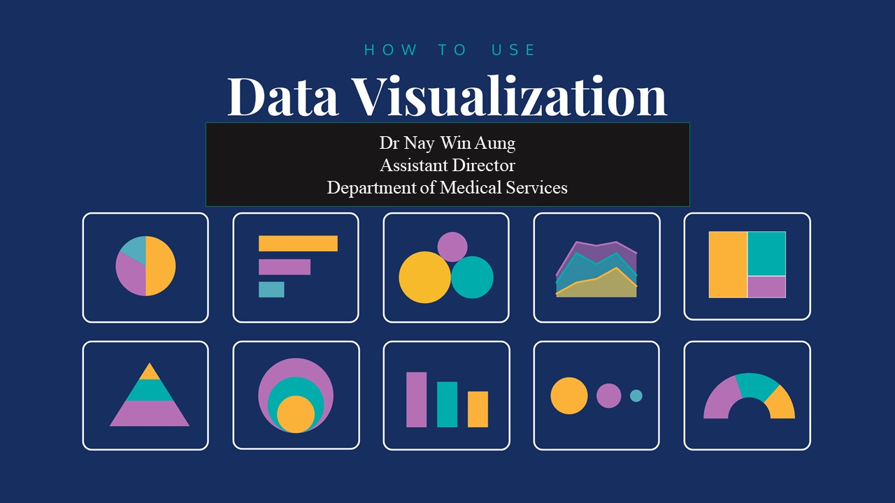

Slide 2
What is data visualization?
A simple definition of data visualization:
Data visualization is the visual presentation of data or information. The goal of data visualization is to communicate data or information clearly and effectively to readers. Typically, data is visualized in the form of a chart, infographic, diagram or map.
The field of data visualization combines both art and data science. While a data visualization can be creative and pleasing to look at, it should also be functional in its visual communication of the data.

Slide 3
Data visualization can be used for:
Making data engaging and easily digestible
Identifying trends and outliers within a set of data
Telling a story found within the data
Reinforcing an argument or opinion
Highlighting the important parts of a set of data

Slide 4
infographic types:
Statistical infographics
Informational infographics
Timeline infographics
Process infographics
Geographic infographics
Comparison infographics
Hierarchical infographics
List infographics
Resume infographics
the most common types of charts are:
Bar graphs/charts
Line charts
Pie charts
Bubble charts
Stacked bar charts
Treemaps
Word clouds
Pictographs
Area charts
Scatter plot charts
Multi-series charts

Slide 5
the most common types of diagrams are:
Flowcharts
Mind maps
Venn diagrams
Tree diagrams
SWOT analysis
Fishbone diagrams
Histograms
Wireframes
Site maps
Use case diagrams

Slide 6
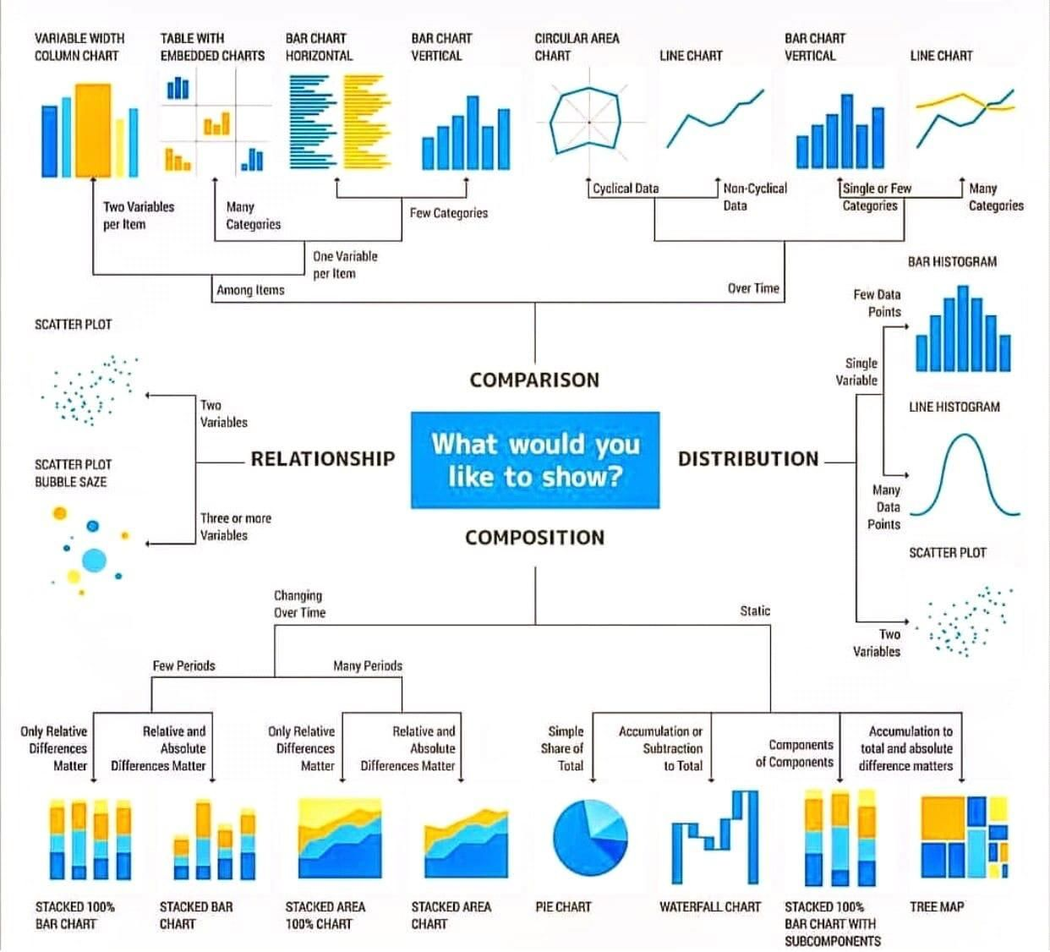

Slide 7
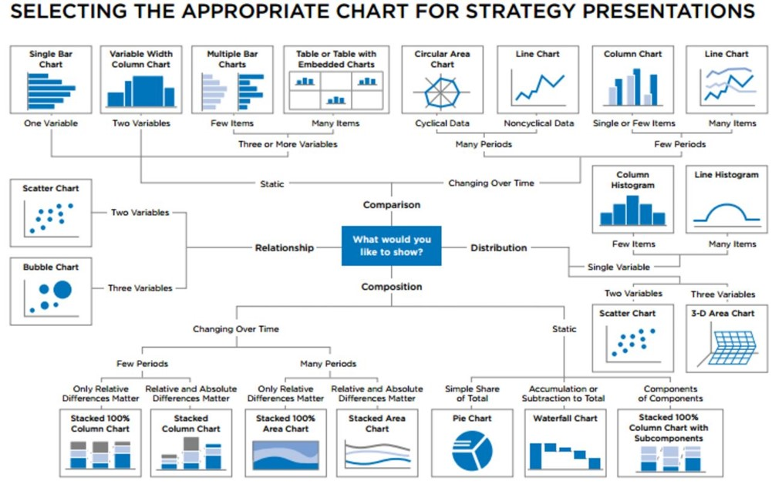

Slide 8
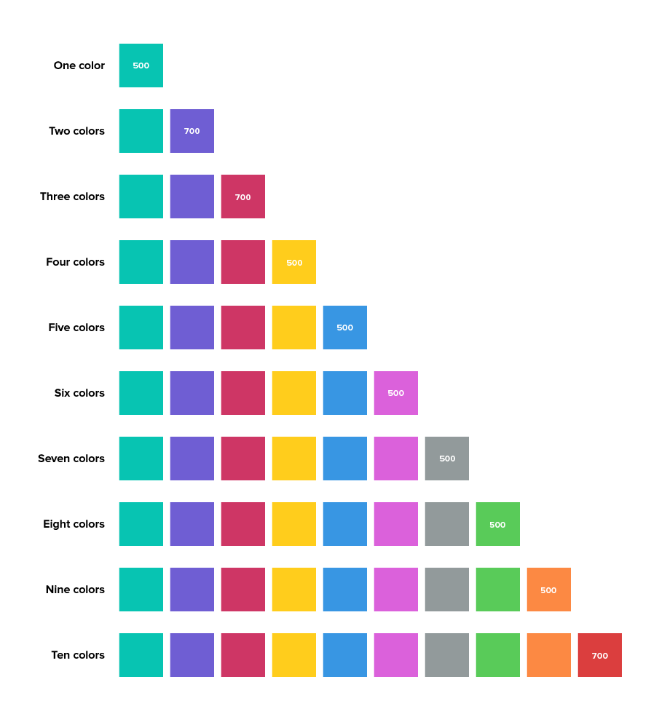

Slide 9
Types of Color Palette
Three major types of color palette exist for data visualization:
Qualitative palettes
Sequential palettes
Diverging palettes

Slide 10
Qualitative palette
A qualitative palette is used when the variable is categorical in nature. Categorical variables are those that take on distinct labels without inherent ordering. Examples include country or state, race, and gender. Each possible value of the variable is assigned one color from a qualitative palette.

Slide 11
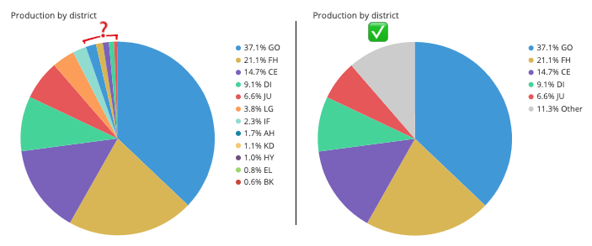

Slide 12
Sequential palette
When the variable assigned to be colored is numeric or has inherently ordered values, then it can be depicted with a sequential palette. Colors are assigned to data values in a continuum, usually based on lightness, hue, or both.

Slide 13

Diverging palette
If our numeric variable has a meaningful central value, like zero, then we can apply a diverging palette. A diverging palette is essentially a combination of two sequential palettes with a shared endpoint sitting at the central value. Values larger than the center are assigned to colors on one side of the center, while smaller values get assigned to colors on the opposing side.

Slide 14
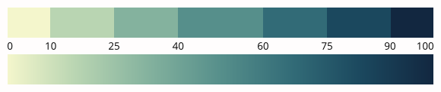
Discrete vs. continuous palette
Sequential and diverging palettes can be associated with data values in two different ways: either as a discrete set of colors, each one associated with a numeric range, or as a continuous function between numeric value and color.

Slide 15
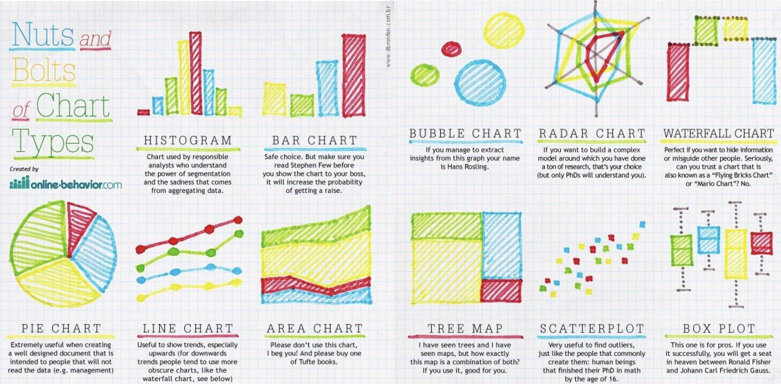

Slide 19
Thank You

