Slide 1
Architecture and Framework of DOMS Website
Dr Nay Win Aung
Assistant Director
Department of Medical Services

Slide 2
Architecture of DOMS Website

Slide 3
CMS Architecture

Slide 4
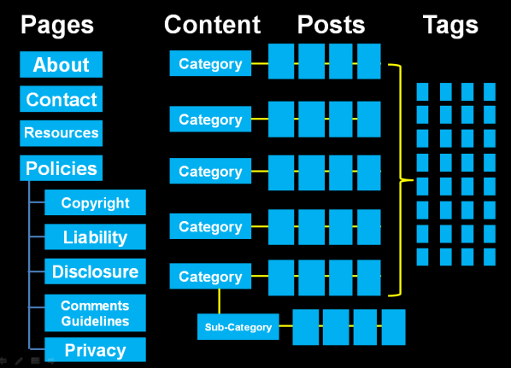
Structure of website

Slide 5
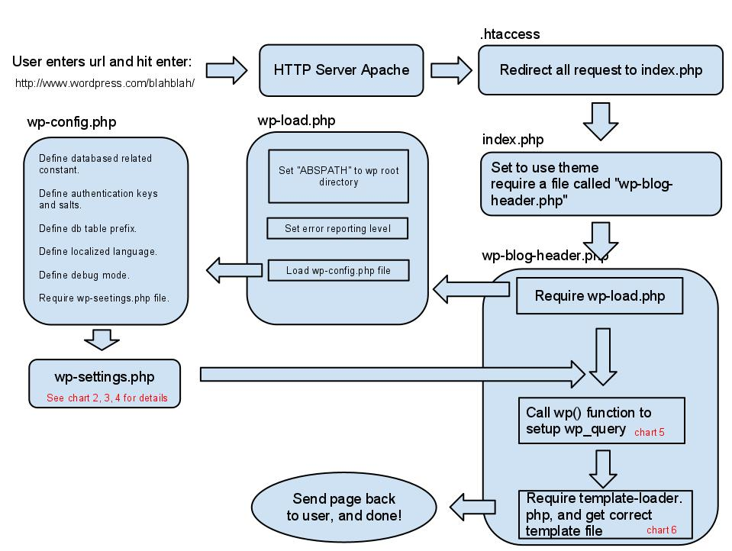

Slide 6
Main Components
Home Page;
News;
Regional News
Hospital News
Department News
Orders and Announcement

Slide 7
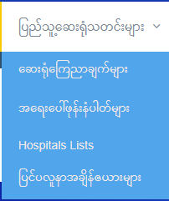
Sub Categories

Slide 9
