Slide 1
Advanced Search in Google
Dr Nay Win Aung
Assistant Director
Department of Medical Services

Slide 2
Google Search Operators Cheat Sheet
This and That
new iPhone deals
Search all words: new, iPhone, and deals;
similar to using AND between the terms
This or That
sailing OR boating
Search sailing or boating
Exact Match
"love me tender"
Search this phrase as a whole
Exclude Words
printer -cartridge
Search printer but hide any results that include cartridge

Slide 3
Definitions define:serendipity Definitions for serendipity
Partial Search san * california Search all words but allow for another word between them
Add 978+456 1434
Subtract 978-456 522
Multiply 978*456 445968
Divide 978/456 2.14473684211
Percentage 50% of 100 50

Slide 4
Power/Exponent 4^18 Calculates 4 to the power of 18, returns 68719476736
Unit Conversion 45 celsius in fahrenheit
Shows how 45 Celsius is expressed in Fahrenheit, returns 113; also works with currencies, weight, distance, and more
Domain Search site:lifewire.com "best phone"
Search lifewire.com for "best phone"
News Source tesla source:lifewire
Search Google News for Tesla, but prioritize results from Lifewire
Search a Range "Android phone" $300..$500
Search "Android phone" but only show results where the price ranges from $300-$500; also works for dates and other numbers
Cache Search cache:lifewire.com The latest cached version of lifewire.com
Filetype Search filetype:pptx zoology
Search all PPTX files that include the word zoology (not all file extensions are supported)

Slide 5
Title Search title:running
Search for pages with running in the title; use allintitle to search multiple words
URL Search inurl:chewbacca
Search for pages that include chewbacca in the URL; use allinurl to search multiple words
Body Text Search intext:parlor
Search for pages that include parlor in the body of the page (won't return pages that include the search in the title or URL but not the body); use allintext to search multiple words
Words by Proximity tech AROUND(3) android
Search tech and android, but only show results where the terms are within three words of each other
Related Sites related:engadget.com
Find websites that have similar content as another one

Slide 6
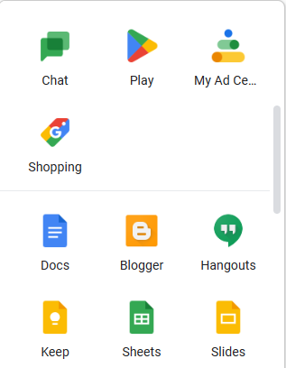
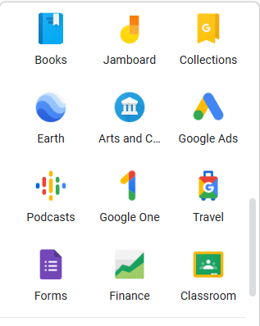
Google Services

Slide 7
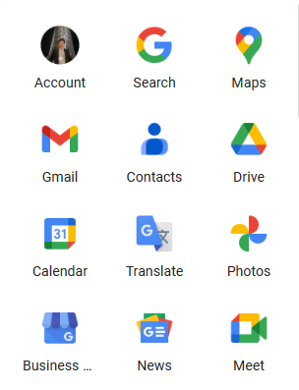
Map
Mail
Storage
Translate
Photo
Video Conferencing

Slide 8
Word
Note
powerpoint
Excel

Slide 10
Thank You

