Slide 1
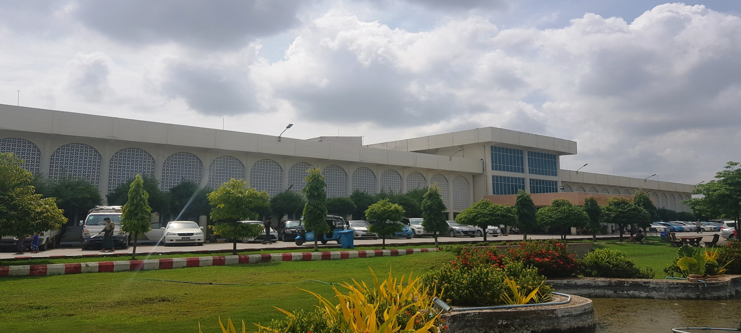
Surveillance of hospital infection and control
(300)Bedded Teaching Hospital, Mandalay.

Slide 2
Planning for surveillance
Infection prevention and control committee
Area of surveillance
Definition of surveillance
Data analysis
Time frame for further action

Slide 3
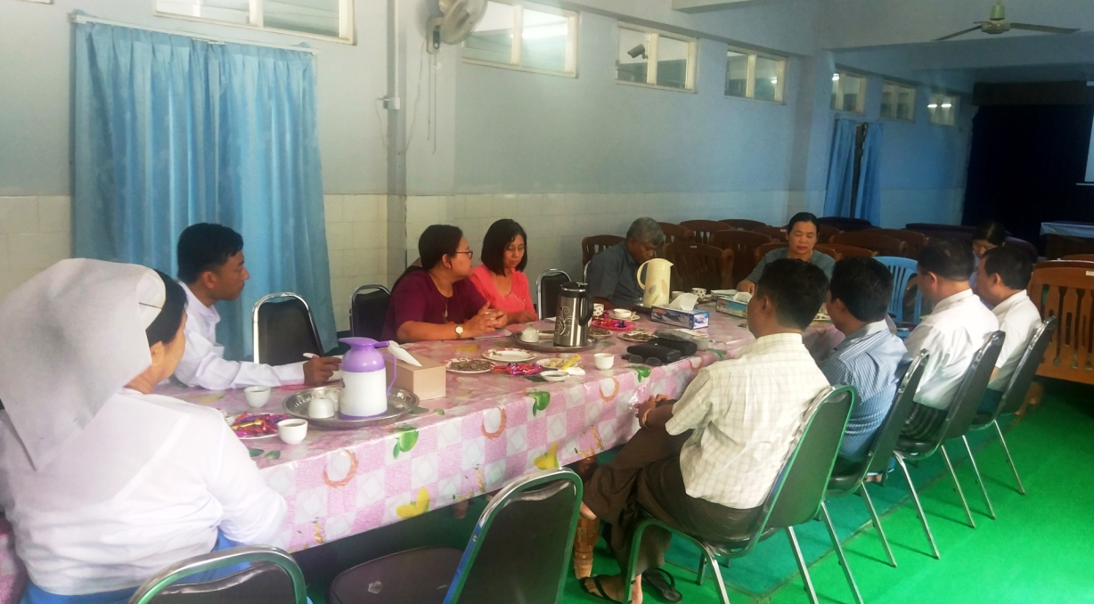
Decisions
Monitoring of Hand washing practices
Incident reports
Surgical site infections
Neonatal sepsis
Fourth day fever surveillance

Slide 4
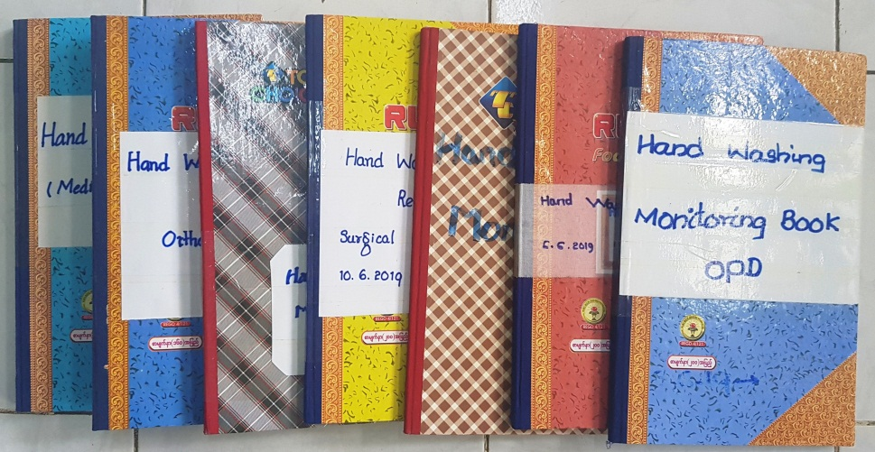
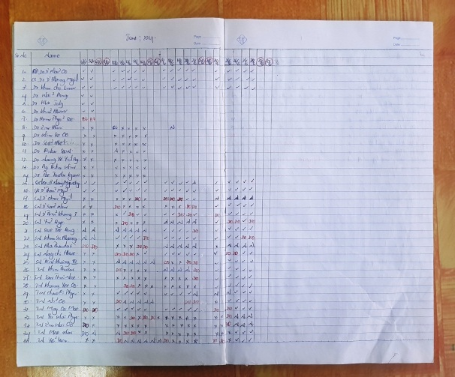
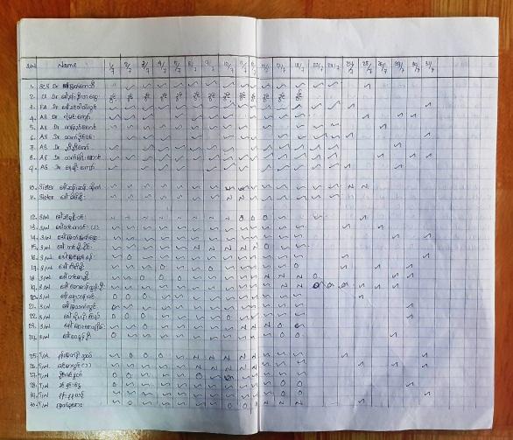
Monitoring of Hand washing
Focal person- Ward Sisters
For doctors, Nurses and workers
Time frame – three months
Emphasized for compliance of standard hand washing procedure
Without informing

Slide 5
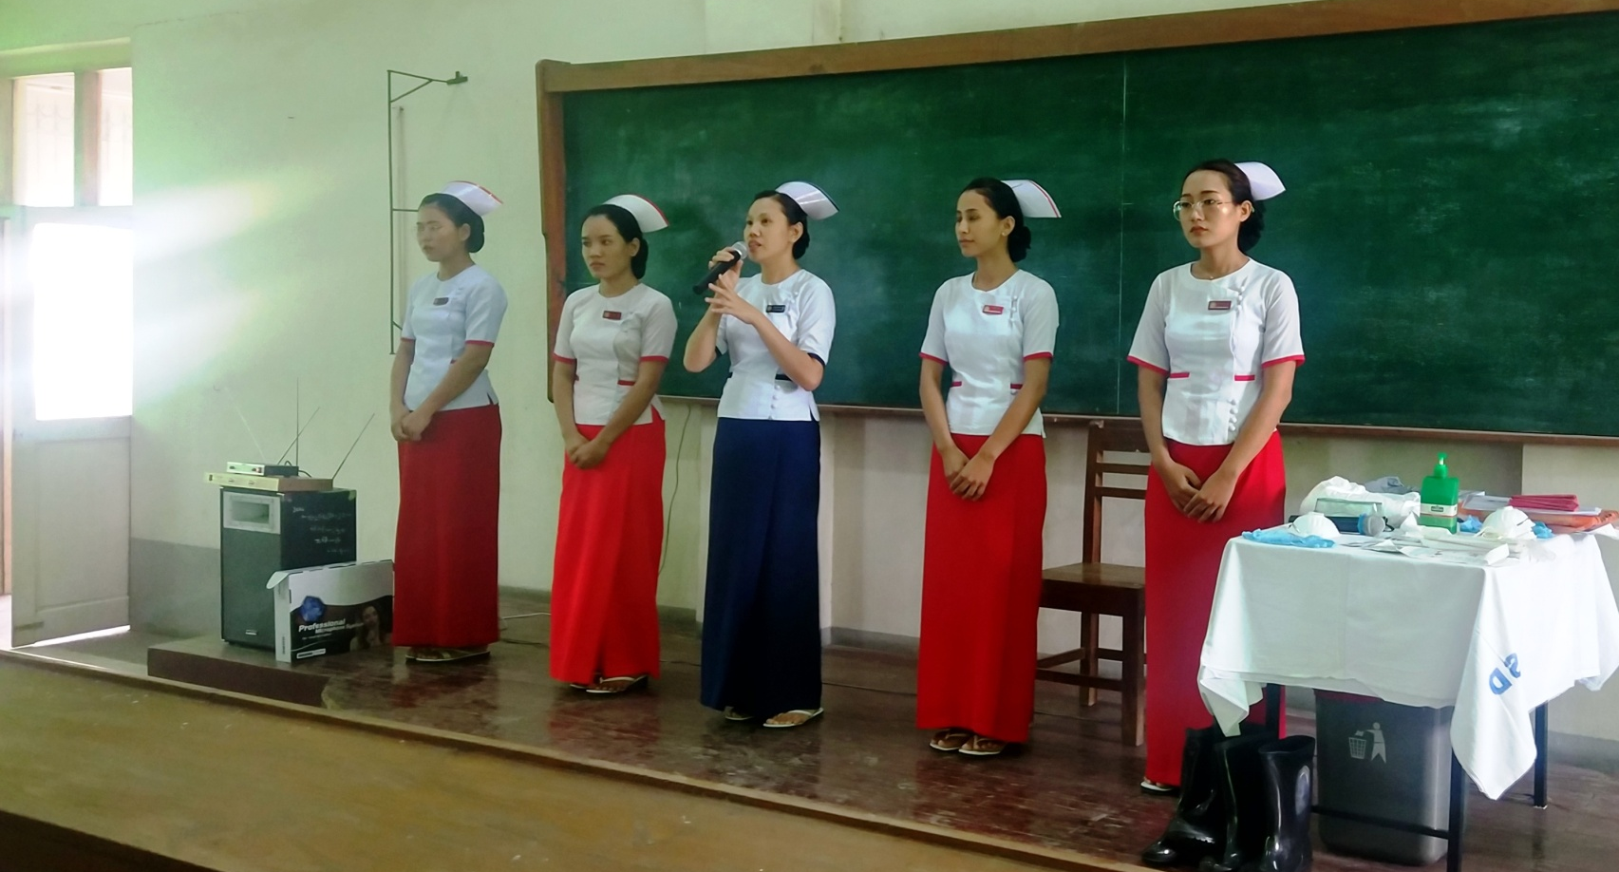
Hand washing
CME
Training for all health staffs

Slide 6
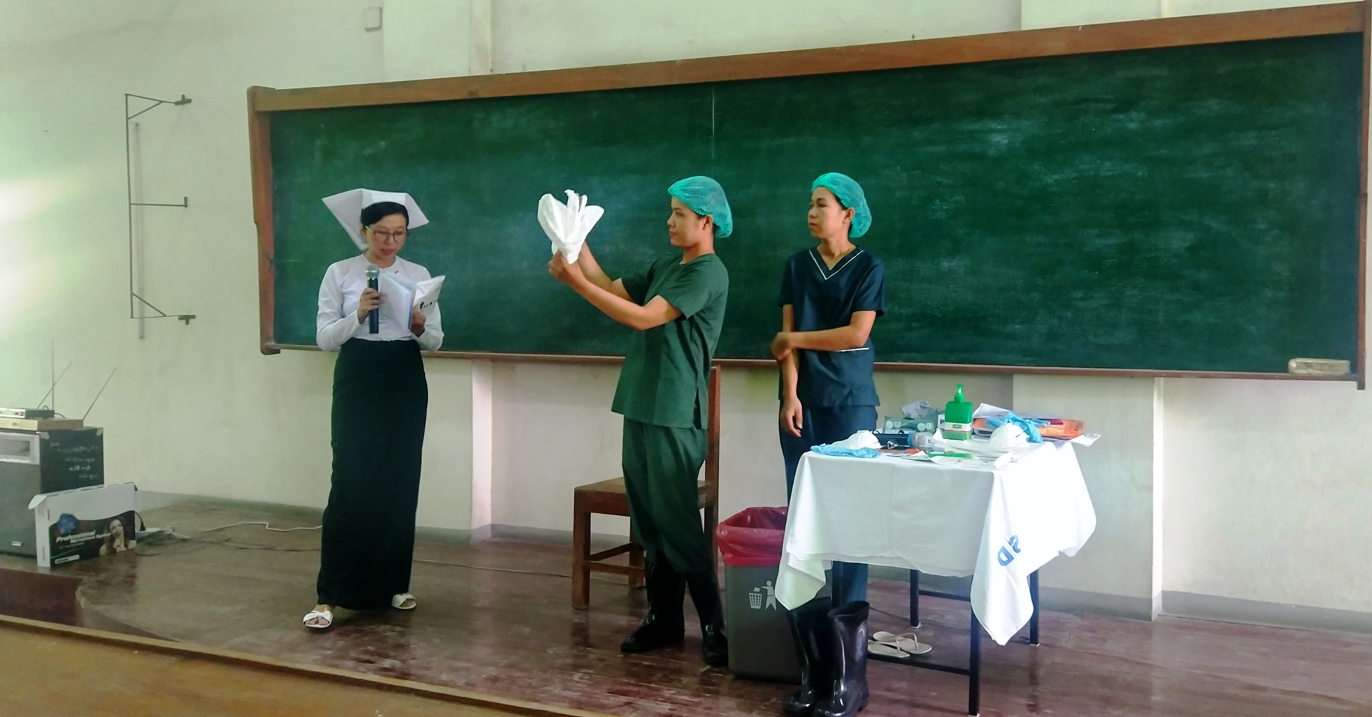
Hand washing
PPE drill

Slide 7
Surgical site infections surveillance
Surgical ward, OG ward, Ortho ward
Emergency or Elective operation

Slide 8
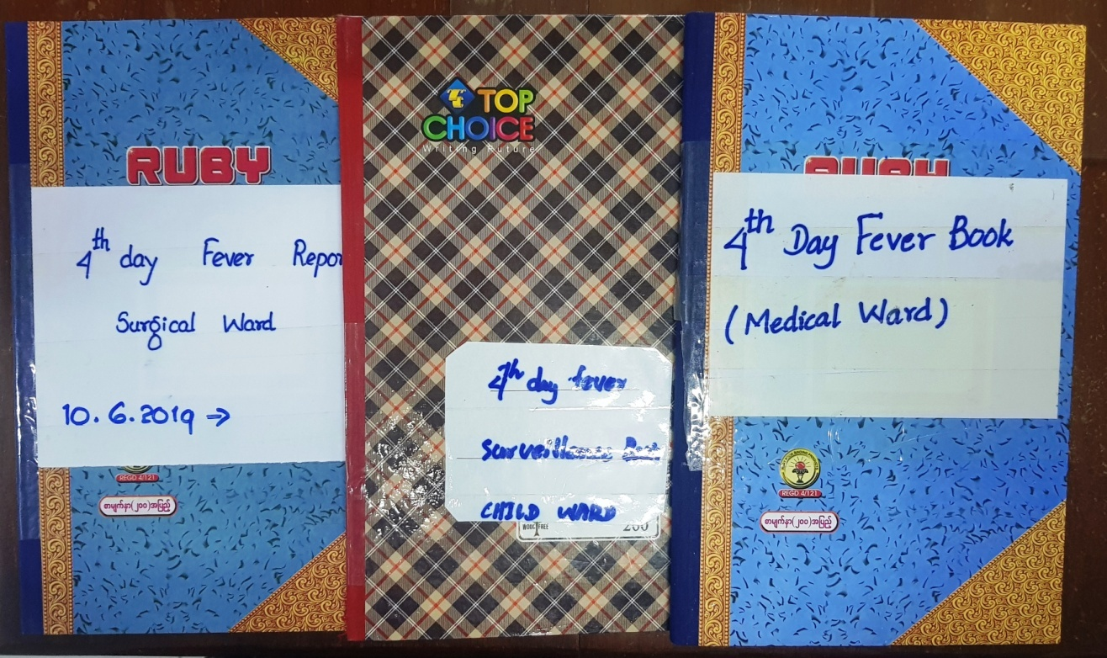
Fourth day fever surveillance
Surgical ward, OG ward, Ortho ward
Emergency or Elective operation
Especially in medical and child ward

Slide 9
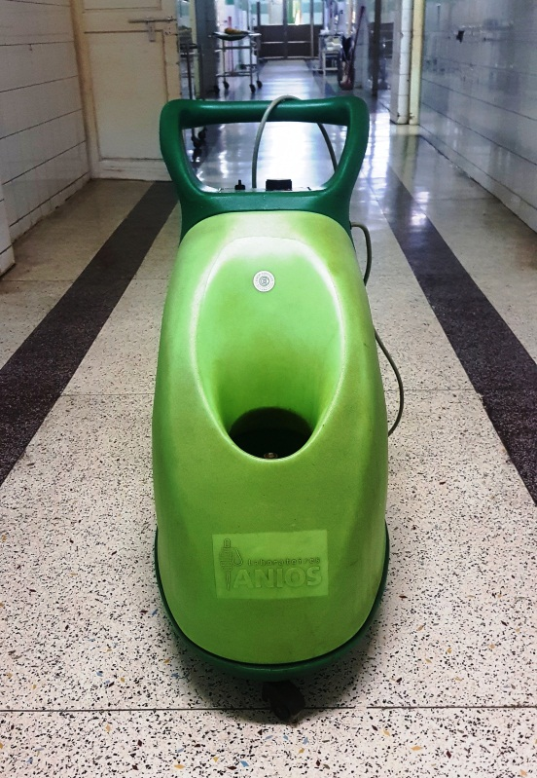
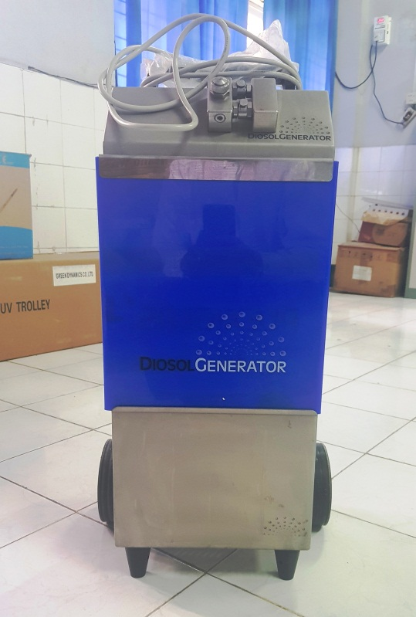
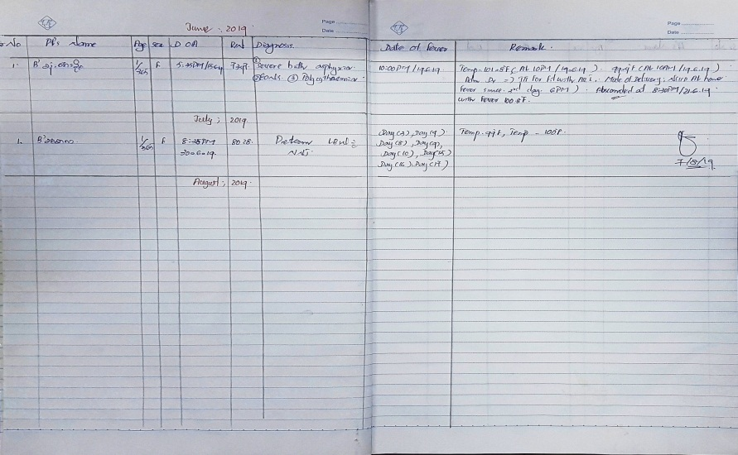
Neonatal sepsis surveillance
Prompt action
Swab culture for neonatal ward
Also delivery room and OT room
Fogging with alternative disinfectants
Aseptanios
H2O2

Slide 10
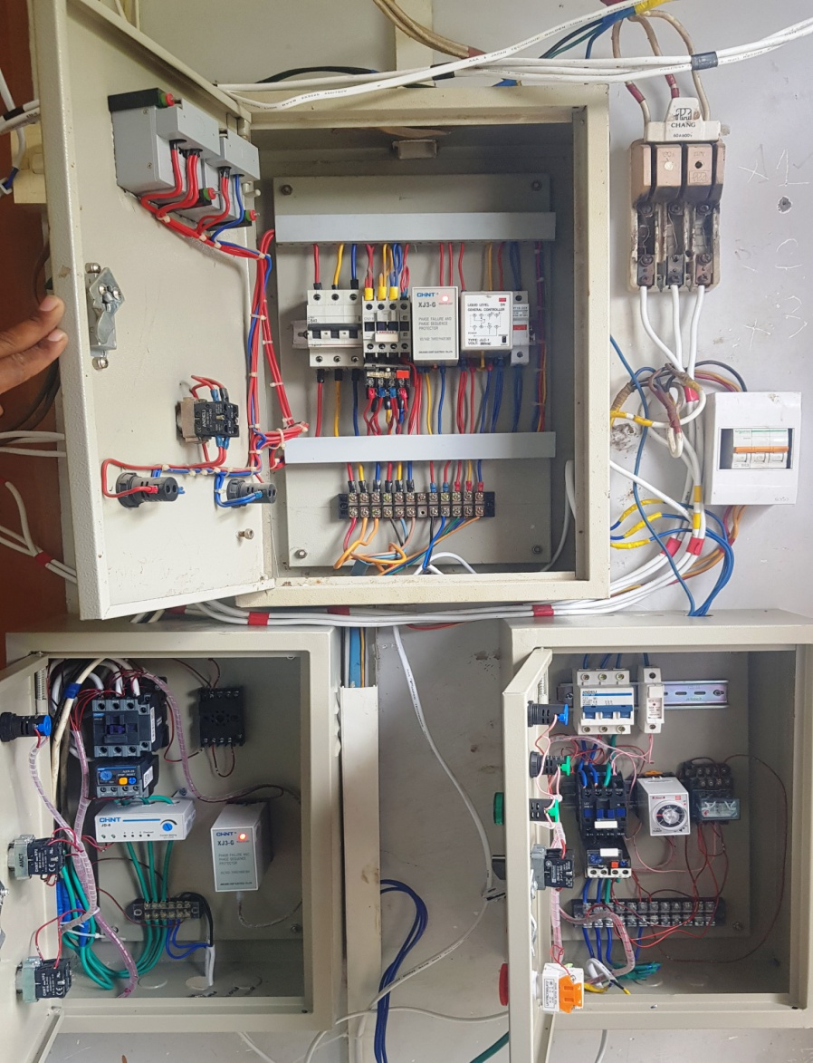
24 hour running water

Slide 11
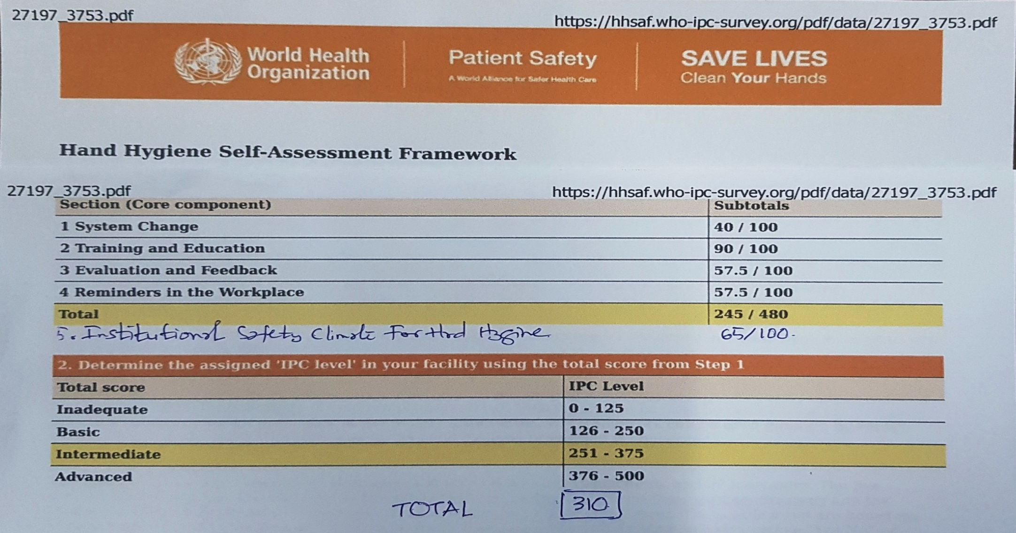
WHO global survey (1)
Hand hygiene self-assessment framework

Slide 12
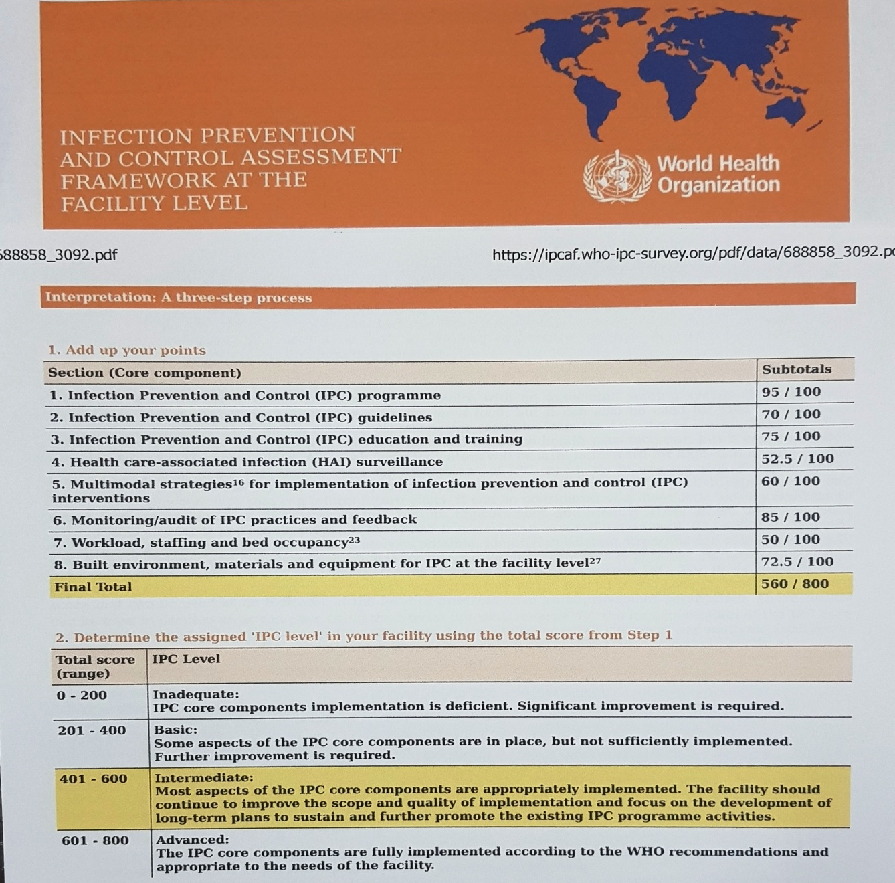
WHO global survey (2)
IPC assessment framework (eight core component)
Final total-560/800
Intermediate level

Slide 13
Problems for surveillance
Poor reliable surveillance case definitions according to international definitions e.g. CDC NHSN/ECDC
Use of standardized data collection methods (for e.g. active prospective surveillance)
Processes in place to regularly review data quality
Feedback for up-to-date surveillance information
To develop mutual trust among health providers
Subtotal score for (HAI) surveillance 52.5/100

Slide 14
Thank you very much
Dr. Thant Zin Tun, DMS

